Slide 1


Space Rover Community
Progress Presentation #2

Slide 2
Outline:
1- Sub-team Progress
2- General Conclusions
3- References

Slide 3
1-
Sub-team progress

Slide 4
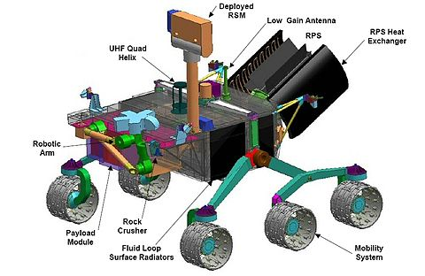
The spacecraft’s built-in Laboratory:
AS7265x
How does spectroscopy work
Working with Arduino
Basic functions
Sub-team representer:
Med. Hedi Ben Jmeaa

Slide 5
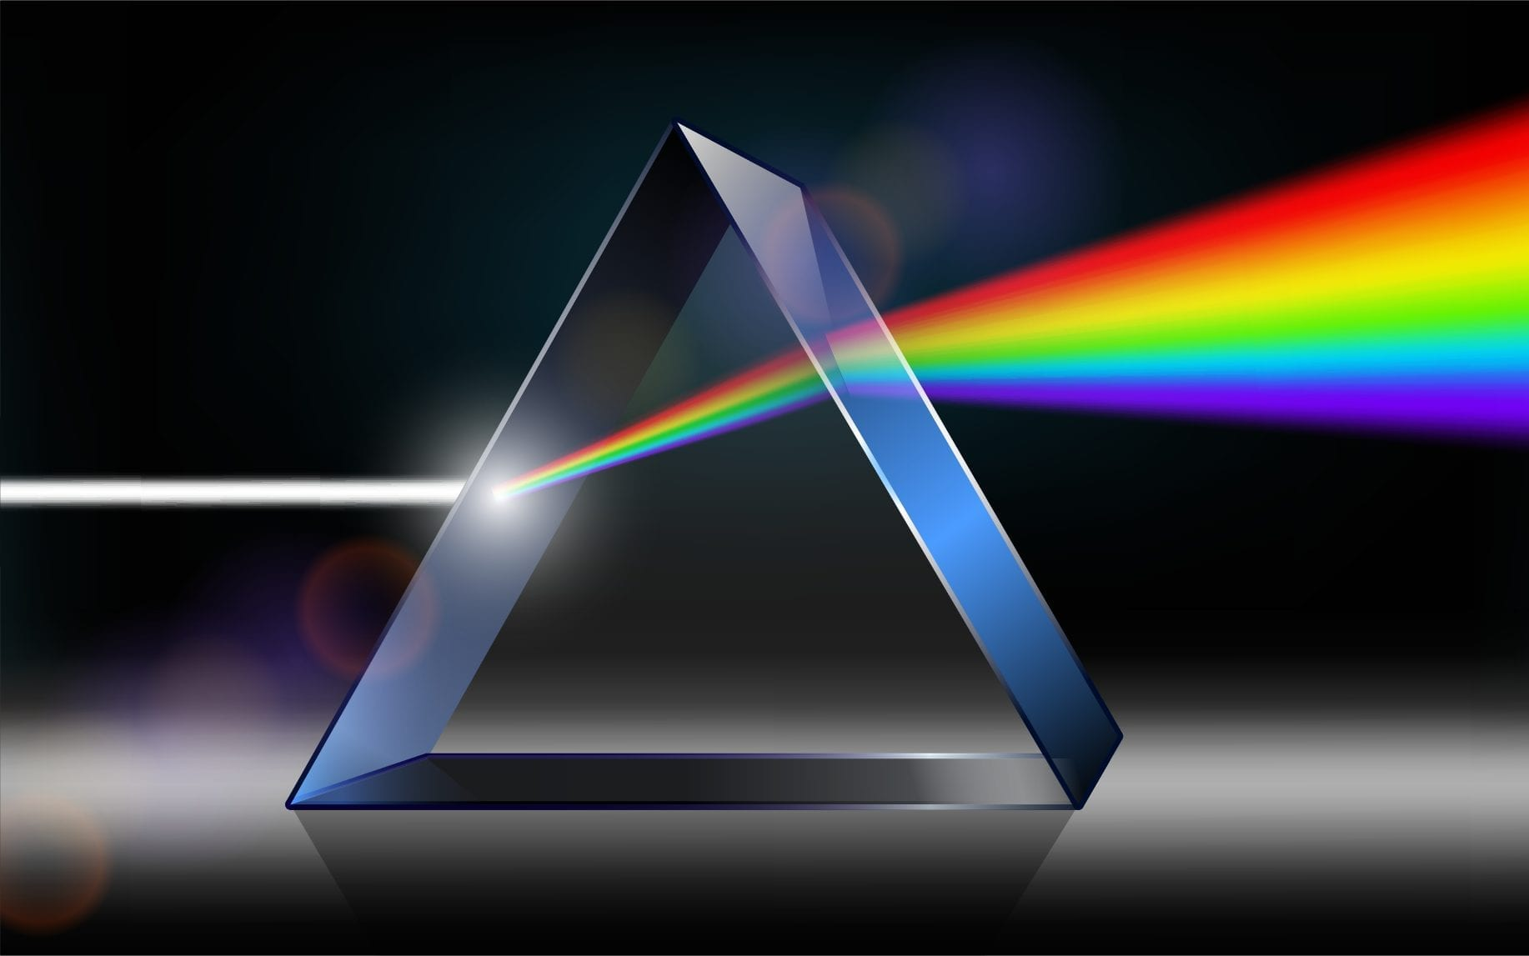
Light Spectroscopy
When light is projected onto matter, there is a changement in the light’s path.
The Interaction can be with absorption or with emission.

Slide 6
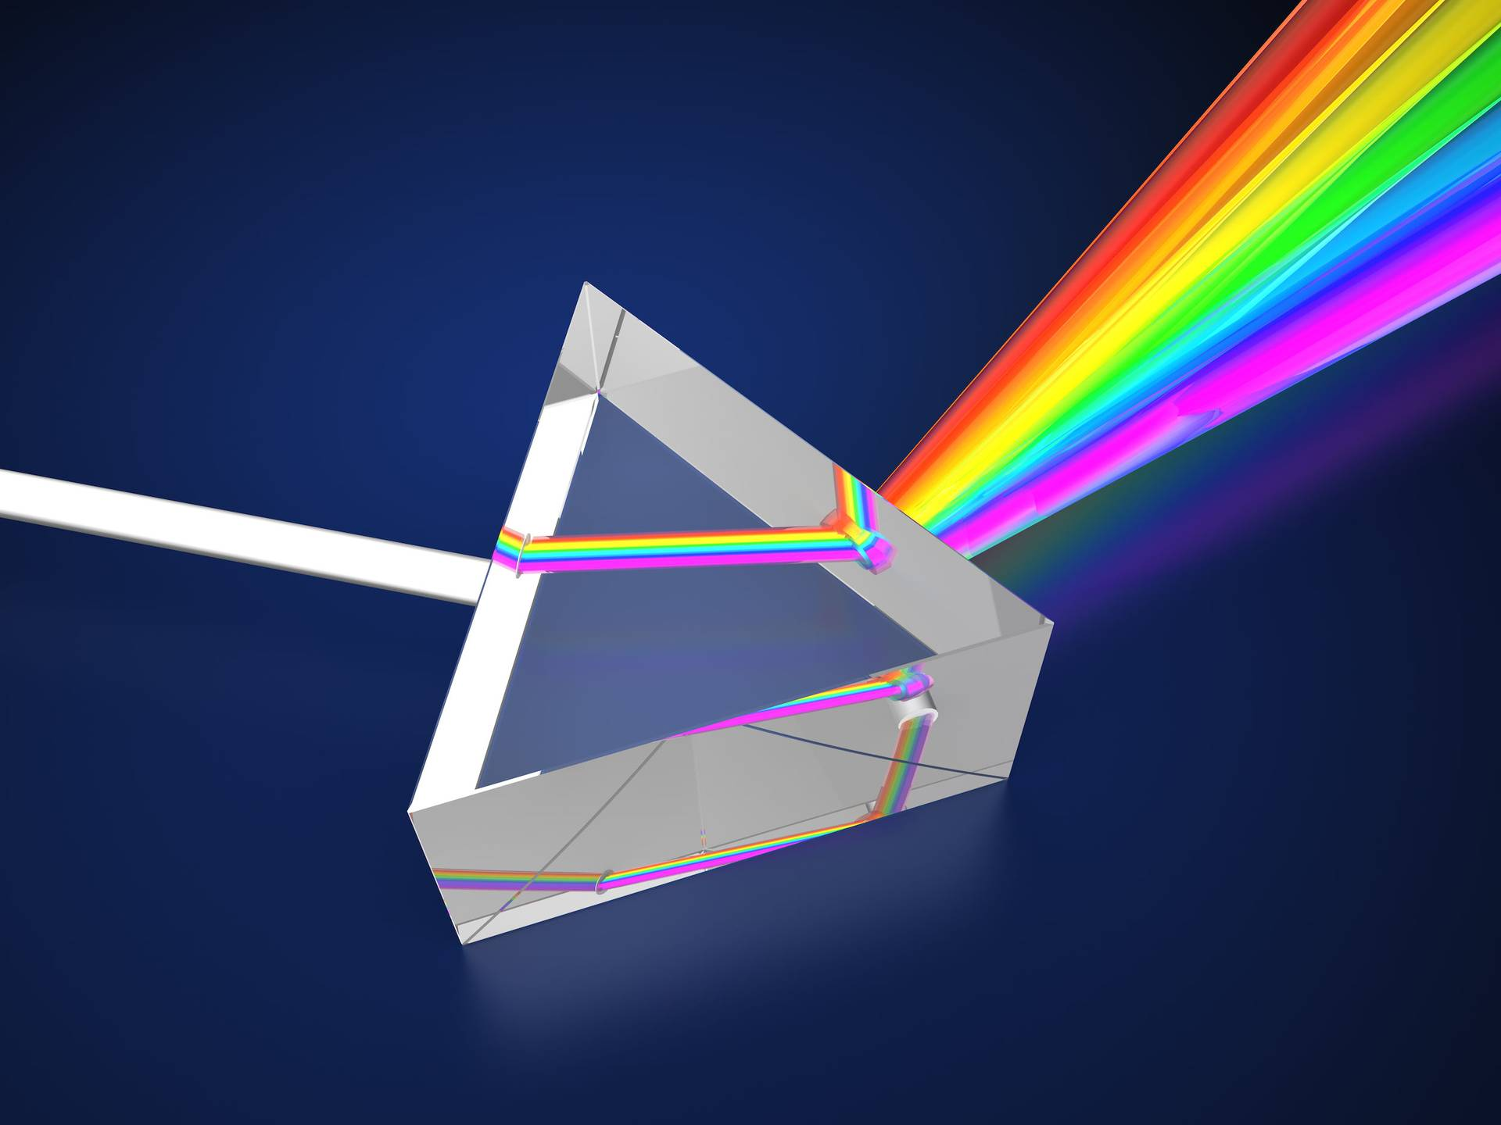
Light Spectroscopy
Spectroscopy is the study of the absorption and emission of light and other radiation by matter. It involves the splitting of light (or more precisely electromagnetic radiation) into its constituent wavelengths (a spectrum), which is done in much the same way as a prism splits light into a rainbow of colours.
1st Phase is absorbing light 2nd Phase is the emission of light

Slide 7
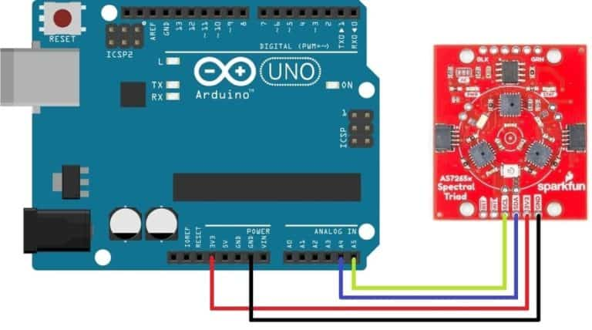
Working with Arduino
A simple sketch of how the sensor can work with Arduino

Slide 8
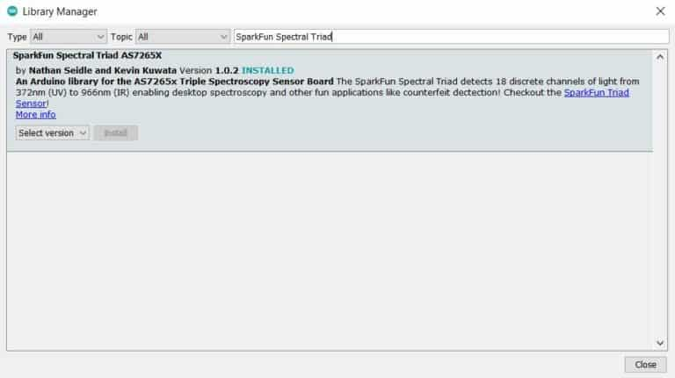
AS7265x Arduino Library
The AS7265x sensor is developed by Sparkfun. So, they have written an Arduino library to get reading from the AS7265x Spectral Sensor.

Slide 9
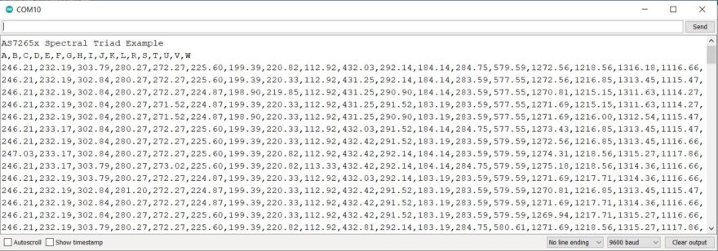
Basic Examples
Basic Reading of all 18 Channels.
The Values change when changing the color of the objects the sensor is sensing.

Slide 10
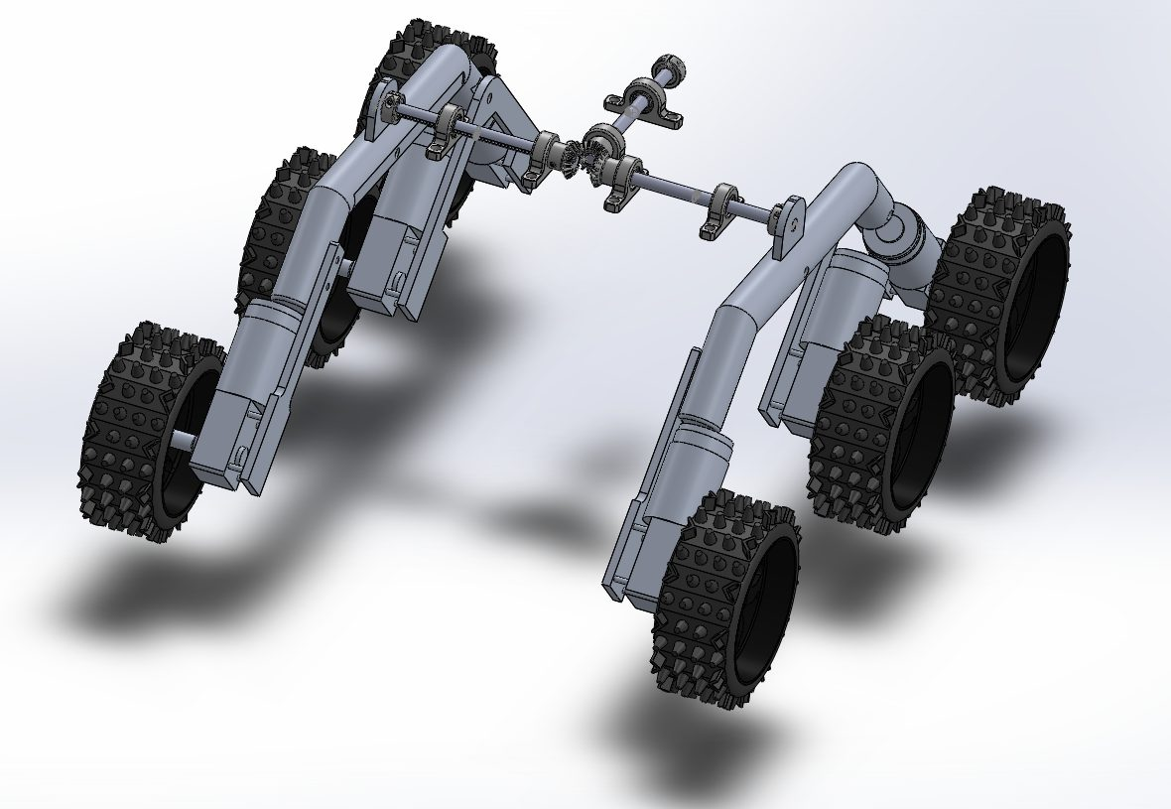
The spacecraft’s Drive-Train Mechanism:
I- Object Avoidance Mechanism
II-
Sub-team representer:
Yasmine Kharrat

Slide 11
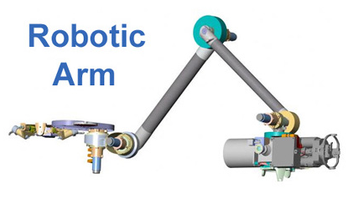
The spacecraft’s Intake Arm Mechanism:
I- Our rev material
II- Choosing what to use
III- Designing the material
Sub-team representer:
E. Lahiani

Slide 12
2-
Our feelings, our visions and general conclusions

Slide 13
3- References:

Slide 14
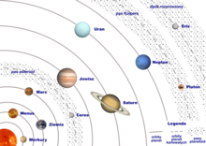
Thank you for your attention.

